Slide 1
Chapter 19
Chemical Thermodynamics

Slide 2
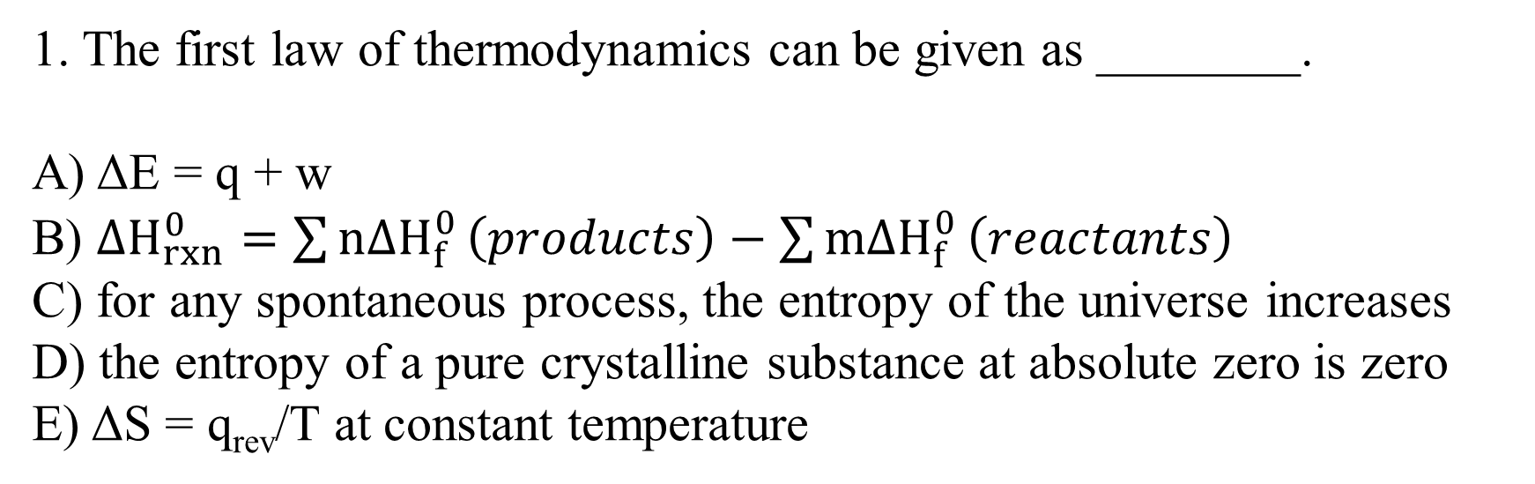
1. The first law of thermodynamics can be given as ________.
A) ΔE = q + w
B) $∆H_{rxn}^{0}=\sum{n{∆H}_{f}^{0}}\left(products\right)−\sum{m{∆H}_{f}^{0}}\left(reactants\right)$
C) for any spontaneous process, the entropy of the universe increases
D) the entropy of a pure crystalline substance at absolute zero is zero
E) ΔS = q_{rev}/T at constant temperature
A

Slide 3
2. Which one of the following is always positive when a spontaneous process occurs? ________
A) ΔS_{system}
B) ΔS_{surroundings}
C) ΔS_{universe}
D) ΔH_{universe}
E) ΔH_{surroundings}
C
The second law of thermodynamics: any irreversible process results in an increase in the entropy of the universe, whereas any reversible process results in no change in the entropy of the universe

Slide 4
3. ΔS is positive for the reaction ________.
A) 2NO (g) + O₂ (g) → 2NO₂ (g)
B) 2N₂ (g) + 3H₂ (g) → 2NH₃ (g)
C) C₃H₈ (g) + 5 O₂ (g) → 3CO₂ (g) + 4 H₂O (g)
D) Mg (s) + Cl₂ (g) → MgCl₂ (s)
E) C₂H₄ (g) + H₂ (g) → C₂H₆ (g)
C

Slide 5
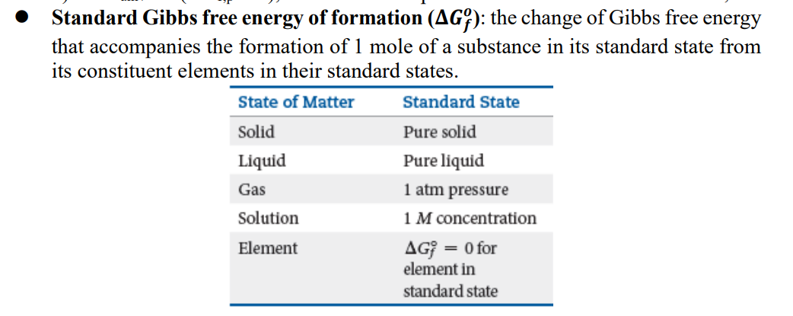
4. The standard Gibbs free energy of formation of ___ is zero. (a) H₂O (l) (b) Fe (s) (c) I₂ (s)
A) (a) only B) (b) only C) (c) only D) (b) and (c) E) (a), (b), and (c)
D

Slide 6
5. For the reaction
2 C₄H₁₀ (g) + 13 O₂ (g) → 8 CO₂ (g) + 10 H₂O (g)
ΔH° is -125 kJ/mol and ΔS° is +253 J/K ∙ mol. This reaction is ______.
A) spontaneous at all temperatures
B) spontaneous only at high temperature
C) spontaneous only at low temperature
D) nonspontaneous at all temperatures
E) unable to determine without more information
A

Slide 7
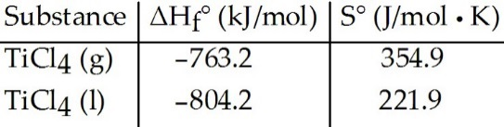


6. Given the following table of thermodynamic data,
complete the following sentence. The vaporization of TiCl₄ is ________.
A) spontaneous at all temperatures
B) spontaneous at low temperature and nonspontaneous at high temperature
C) nonspontaneous at low temperature and spontaneous at high temperature
D) nonspontaneous at all temperatures
E) not enough information given to draw a conclusion
C
= 40.2 KJ
= 133*10⁻³ KJ

Slide 8
7. With thermodynamics, one cannot determine ________.
A) the speed of a reaction
B) the direction of a spontaneous reaction
C) the extent of a reaction
D) the value of the equilibrium constant
E) the temperature at which a reaction will be spontaneous
A

Slide 9
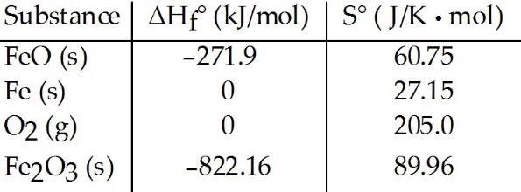
K=$e^{−\frac{G}{RT}}=$
8. Consider the reaction:
FeO (s) + Fe (s) + O₂(g) → Fe₂O₃ (s)
Given the following table of thermodynamic data at 298 K:
The value K for the reaction at 25 °C is ________.
A) 370
B) 5.9 × 10⁴
C) 3.8 × 10⁻¹⁴
D) 7.1 × 10⁸⁵
E) 8.1 × 10¹⁹
D
= -822.16+271.9 =-550.26 KJ/mol
= 89.96-205.0-27.15-60.75 = -202.94 J/K·mol
G= -550260 +202.94*298 = -4.89*10⁵J/mol

Slide 10
9. The normal boiling point of methanol is 64.7 °C and the molar enthalpy of vaporization is 71.8 kJ/mol. The value of ΔS when 1.75 mol of CH₃OH (l) vaporizes at 64.7 °C is ________ J/K.
A) 0.372
B) 4.24 × 10⁷
C) 372
D) 1.94 × 10³
E) 1.94
C

